Slide 1

UGANDA MARTYRS UNIVERSITY
FACULTY OF SCIENCE
DEPARTMENT OF COMPUTER SCIENCE AND INFORMATION SYSTEMS
ENTERPRISE BUSINESS ANALYTICS TAKE HOME PROJECT
Name | REGISTRATION No. | STUDENT No.
MUSINGUZI JIMMY | 2023-M132-21504 | 2300501504

Slide 2
Introduction
Objective of the assignment
The main objective of the assignment is to analyze the quality of arabica coffee beans exported globally and get insights on how to be competitive as a country on the arabica coffee global market.
Description of the dataset
This project uses the Coffee Quality Dataset, collected by the Coffee Quality Institute in January 2018. The data was retrieved from tidytuesday, courtesy of James LeDoux, a Data Scientist at Buzzfeed. The data is collected on Arabica coffee beans from across the world and professionally rated on a 0-100 scale based on factors like acidity, sweetness, fragrance, balance, etc. The dataset also contains information about the country of origin of the coffee beans, harvesting and grading date, colour of the beans, defects, processing and packaging details. There are 1312 observations in the dataset and 53 variables.
The dataset had a total number of 1, 0497 null values, 1,312 unique values and 53 columns. The main features from the dataset that were used in data analysis included quality score, country of origin, flavor, acidity, sweetness, aroma, moisture, bag weight, colour and defects.

Slide 3
Data Collection
This project uses the Coffee Quality Dataset collected by the Coffee Quality Institute in January 2018. The data was retrieved from tidytuesday, courtesy of James LeDoux, a Data Scientist at Buzzfeed. The data was collected on Arabica coffee beans from across the world and professionally rated on a 0-100 scale based on factors like acidity, sweetness, fragrance, balance, etc. The dataset also contains information about the country of origin of the coffee beans, harvesting and grading date, colour of the beans, defects, processing and packaging details . There are 1312 observations in the dataset and 53 variables and 37 unique countries of origin.

Slide 4
Insights from the Data Visualizations
Power BI was used to conduct data visualization for the data set and below were my findings.
Aroma: Uganda’s coffee scores 7.9 points and comes second after Papua New Guinea with 8.33 points out of 10. Aroma of a coffee is assessed by inhaling the aroma released when hot water is poured over the ground coffee. The aroma can vary from floral and fruity to nutty or chocolatey, and it provides important clues about the coffee’s potential flavor profile.
Flavor: Uganda’s coffee scores 7.75 0ut of 10 points and comes 6th after Papua New Guinea (8.42), United States (8.14), Ethiopia (7.96), Rwanda (7.92), Kenya (7.78). Flavor defines the length of the flavor once the coffee has been swallowed. The longer the pleasant trail, the better the score.
Sweetness: Most of the countries tied with a score of 10 Uganda inclusive. Sweetness is evaluated based on the coffee’s natural sweetness and lack of unpleasant bitterness.
Total Cupper Points: Uganda scored 84.052 out of 100 points and is the 6th after United States, Papua New Guinea, Japan, Ethiopia, and Kenya. This qualifies Uganda Arabica Coffee to be categorized as a Specialty Coffee. Cupping is a standardized tasting method used to assess the quality and characteristics of coffee beans. It involves brewing coffee samples and evaluating them in a controlled environment. This process allows cuppers (professional coffee tasters) to objectively analyze and compare various coffees based on specific criteria.

Slide 5
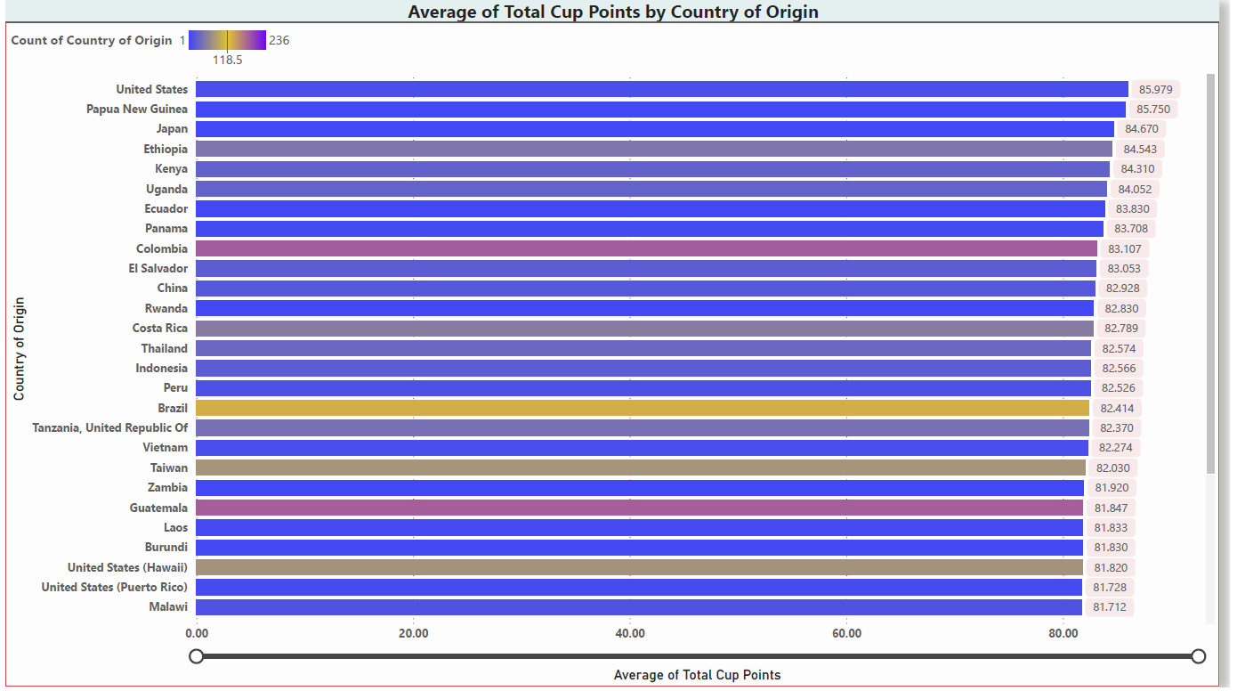
Data Visualization

Slide 6
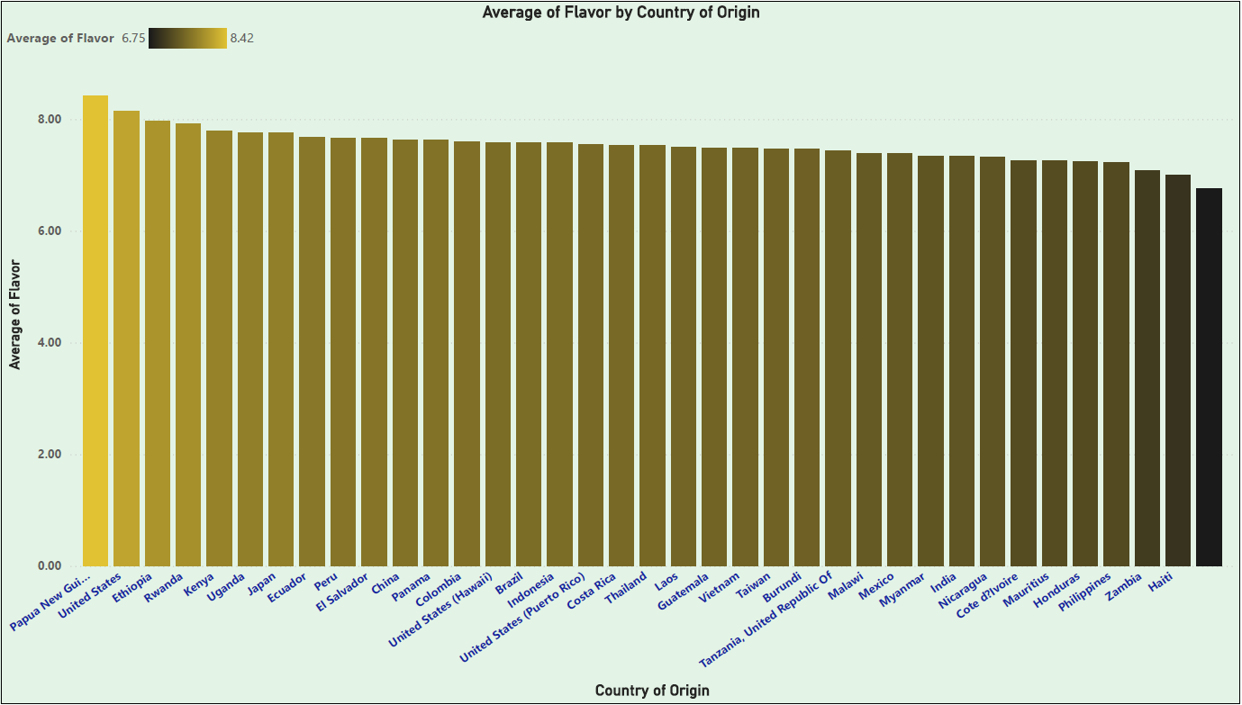
Data Visualization..

Slide 7
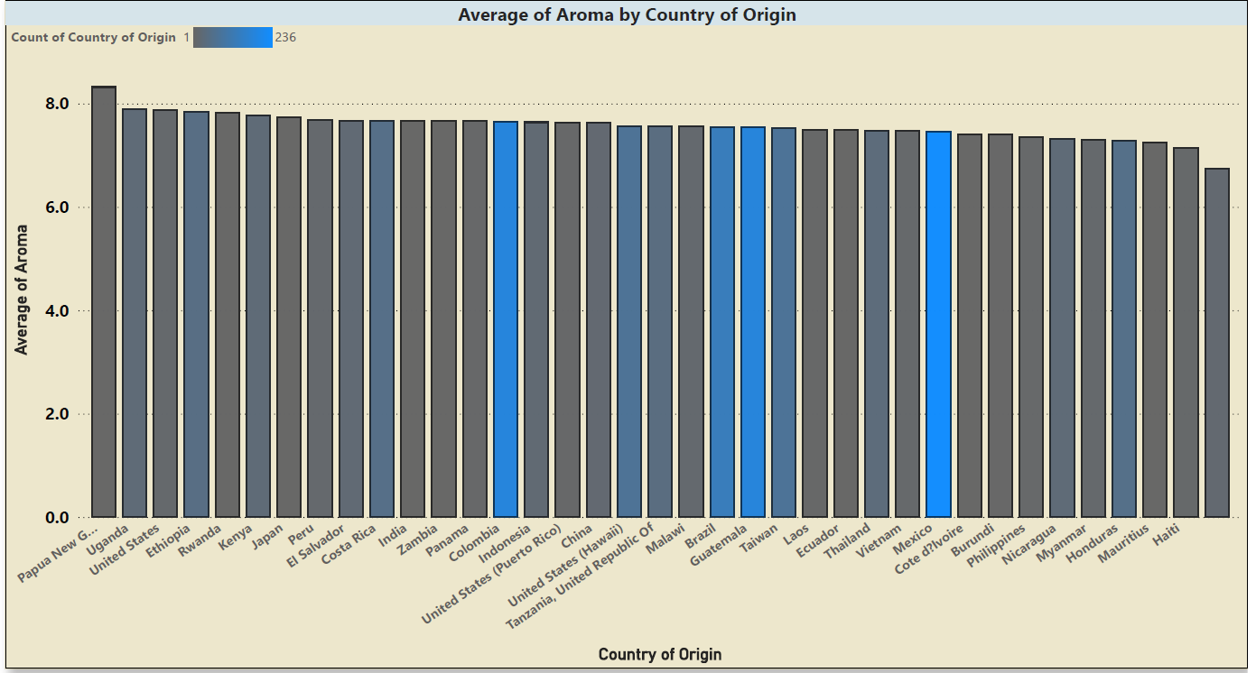
Data Visualization…

Slide 8
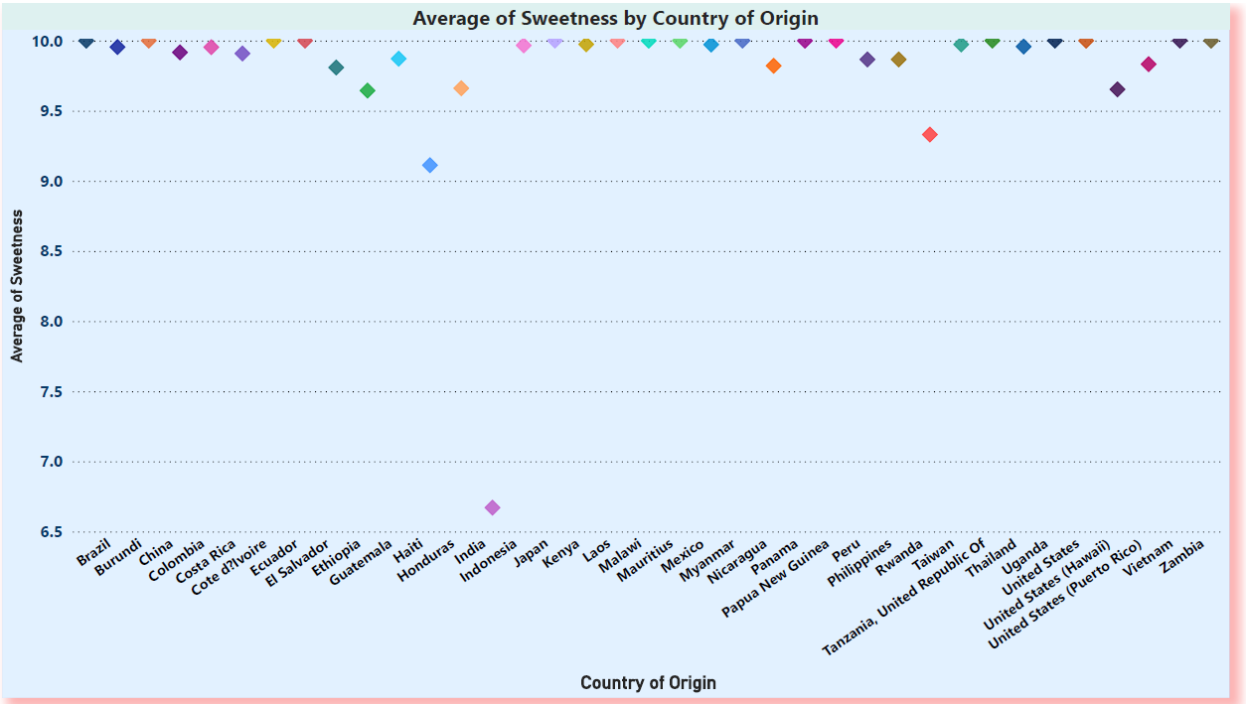
Data Visualization…

Slide 9
Conclusion and Recommendations
On a rate of 0 – 100, the arabica coffee from Uganda scores an average of 84.052 on the total cupper points and is in the top 10 countries that produce the best arabica coffee globally. Given this rating, Uganda has a competitive advantage on the global market, but more efforts are needed to increase on the arabica coffee volumes produced annually.
The government of Uganda and the different coffee stakeholders should invest more in the arabica coffee value chain right from training the farmers to coffee processing. I believe this will increase the arabica coffee volumes as well as the quality of the coffee produced which will enhance our bargaining power and competitiveness as a country.
LINK TO GITHUB REPOSITORY

